Slide 1

Module3 Project
Ieronymakis Emmanouil
Nikolakopoulos Panagioths-Dimitrios

Slide 2

Introduction
The data we are about to present you are the Flourish OA.
This dataset has information about journals or publishers.

Slide 3
Data Description:
We have 3 different datasets.
In the First dataset (“module_project”) we have: 13146 rows and 6 columns(issn,journal_name,pub_name,is_hybrid,category,url)
In the Second dataset(“project_module1”) we have:3615 rows and 8 columns(Unnamed,journal_name,issn,citation_count_sum,paper_count_sum,avg_cites_per_paper,proj_ai,proj_ai_year)
In the Third dataset(“project_module2”) we have:7795 rows and 7 columns(id,price,date_stamp,journal_id,influence_id,url,license)
The data comes from a variety of sources, including researchers, web scraping, and the publishers themselves.

Slide 4
Ηow we organized the project:
We made the decision not to break the project up into portions, instead deciding to work on it collectively until we had gathered all the components we intended to use.
Therefore, we initially began the entire process of cleaning the data.
Our issues with the data included scraped data, blank fields, possible duplication, and encoding issues (also possibly multiple character encodings).

Slide 5
First off all we cleaned the data:
We removed the scraped data by creating a boolean mask that identifies rows with invalid ISSN numbers and using this mask to remove those rows from the DataFrame.
To get rid of blank fields we used the dropna() method.
To get rid of possible duplications we used the drop_duplicates() method.
To fix encoding issues with 'journal_name', we used the encode() method for 'utf-8'.Then, we used the decode() method to decode the byte string back to ASCII encoding.

Slide 6
EDA
After the cleaning we moved to EDA.
For the EDA we used the function .describe() for basic descriptive statistics for numerical columns.
We also used the .info() function to check the data types of each column and more.
And the .nunique() function to fine number of unique values for each column.

Slide 7
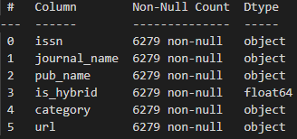
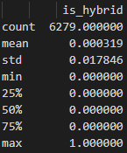
First Dataset EDA
The only column in this dataset which has numerical data is the hybrid.
With just a very small fraction of values being 1, the mean of 0.000319 suggests that the great majority of entries in this column are zero. Given that 75% of the values are zero, this is consistent. Thus, hybrids do not make up 75% of the population.
The 25th percentile, median, and 75th percentile are all 0, indicating that the majority of values in this column are 0.
Overall, this data reveals that only a very tiny percentage of the journals or publishers in the sample are hybrid, with the great majority not being hybrid.

Slide 8
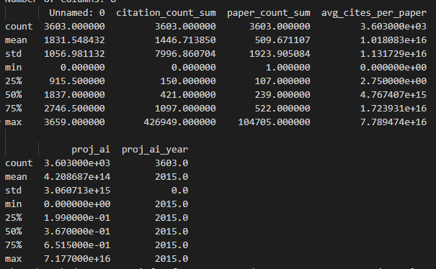
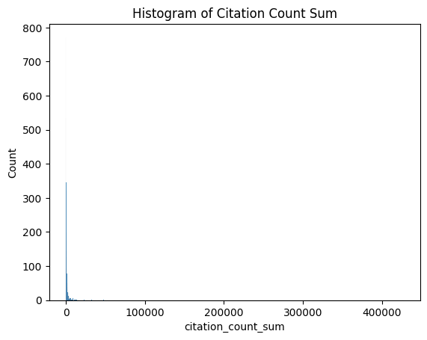
Second Dataset EDA
The information of the Second dataset:
From the citation_count_sum we understand:
The standard deviation of 7996.860704 indicates that the citation counts are quite spread out, with some journals or publishers having very high citation counts and others having very low citation counts.
Overall, the data indicate that the citation counts for the journals or publishers in this dataset are fairly diverse, with a reasonably high mean but a huge standard deviation indicating that there are many outliers with extremely high citation counts. Although 75% of journals or publishers have a citation count of 1097 or fewer, the bulk have relatively low citation counts.

Slide 9
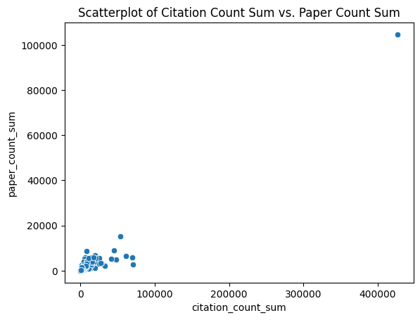
Second Dataset EDA
The information of the Second dataset:
From paper_count_sum we understand:
The mean of 509.671107 indicates that the average number of papers for the journals or publishers in this dataset is around 510.
The standard deviation of 1923.905084 indicates that the number of papers is quite varied, with some journals or publishers having a very large number of papers and others having very few.
The information collectively indicates that the number of articles published by the journals or publishers in this dataset is extremely variable, with a reasonably high mean but a huge standard deviation indicating that there are many outliers with a very large number of papers published. Nonetheless, the bulk of journals or publishers have only released a small number of articles; 75% have done so with 522 or fewer.

Slide 10
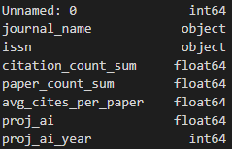
Second Dataset EDA
The information of the Second dataset:
From avg_cites_per_paper we understand:
With a big standard deviation showing that there are numerous outliers with a very high number of citations per manuscript, this information implies that the number of citations per paper for the journals or publishers in this dataset is extremely variable. The dataset's minimal value of 0 also implies that some journals or publishers haven't received any citations at all. However, the median value of 4.767407e+15 shows that the majority of journals or publishers in the dataset have an average number of citations per paper that is significantly lower than the mean, indicating that there are only a few journals or publishers that have extremely high average numbers of citations per paper.

Slide 11
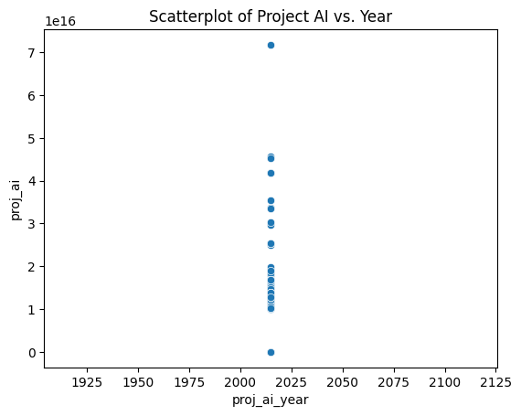
Second Dataset EDA
The information of the Second dataset:
From proj_ai and proj_ai_year we understand:
For the proj_ai:As the mean is significantly higher than the median and the highest value is significantly different from the 75th percentile, we may conclude that the data is heavily right-skewed. The high standard deviation suggests that the data also appear to have a wide range. It's also important to note that the highest value is relatively huge compared to the other values, suggesting that there may be some outliers, and the smallest value is 0, showing that there are some observations with no project AI.
while the proj_ai_year column only contains a single value (2015) for all entries.

Slide 12
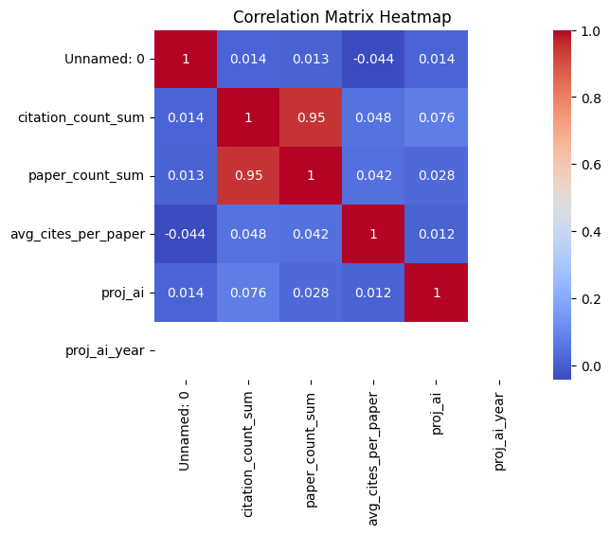
Second Dataset EDA

Slide 13
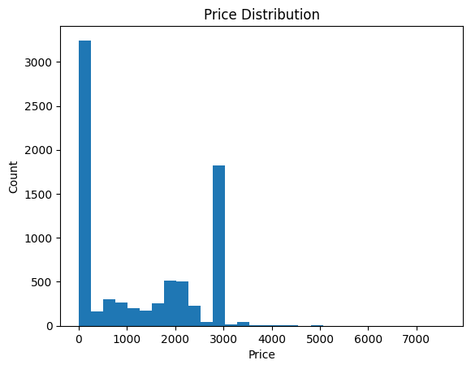
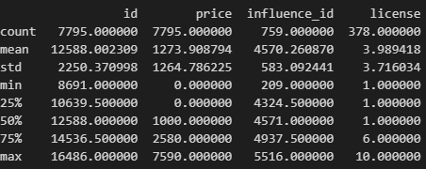
Third Dataset
For the price column:
With a large range of prices from 0 to 7590, these results imply that there may be a substantial degree of fluctuation in the costs of journals and publishers. The median price of $1000, however, makes it possible that many journals or publishers charge less. The fact that 25% of the prices are zero or less might potentially mean that some of the dataset's articles are free.
Overall, the dataset's "price" column seems to be beneficial for understanding the pricing policies of the included journals and publishers and might be relevant for future modeling or research.

Slide 14
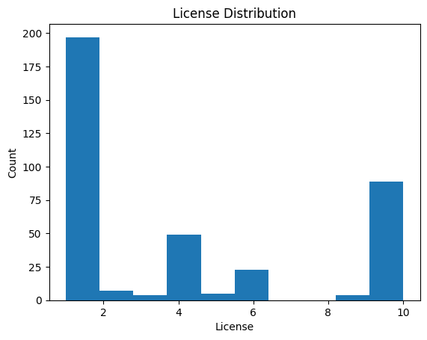
Third Datasetset
For the license column:
With a range of license values from 1 to 10. However, the fact that the median, 25th percentile, and 75th percentile are all 1 suggests that a large majority of the journals and publishers may have the same or similar license values. The standard deviation of 3.72 is relatively high, indicating that there may be some variability in the license values.
Although the high standard deviation and concentration of values at one may suggest that this information is not very informative or useful for modeling or further analysis, overall, the "license" column of the dataset may be helpful for understanding the distribution of licenses among journals and publishers.

Slide 15
To sum up:
The majority of journals or publishers in the sample are not hybrid.
The citation counts for the journals or publishers in this dataset are quite spread out, with some having very high citation counts and others having very low citation counts.
The number of articles published by the journals or publishers in this dataset is extremely variable, with some having a very large number of papers and others having very few.
The number of citations per paper for the journals or publishers in this dataset is extremely variable, with many outliers with a very high number of citations per manuscript.
The price column shows a large range of prices, with the median price being $1000 and 25% of prices being zero or less.
The license column has a range of license values from 1 to 10, but the majority of journals and publishers have the same or similar license values.
Overall, the databases offer insights into the journals' and publishers' traits, including their hybrid status, citation counts, amount of papers published, price policies, and licensing distribution.

